Slide 1
BUILDOTS SUMMARY : 16/02/2020

Slide 2
SUMMARY
29/12/19: 20 experiments testing frame size, camera stitching distances, camera models
05/01/20: 4 experiments at 10 FPS, near stitching setting, double circled path at 1000px and 2000px for FOV and SIMPLE_RADIAL_FISHEYE camera models.
10/01/20: 10 experiments: 5 at 10 FPS and 5 at 20 FPS over the 5 camera models used previously. 1 extra experiment was conducted with buildots’s extraction and calibration script (30 FPS and 1000X504px frames)
13/01/20: Using buildots calibration, 3 experiments at 1000 px frames for 3 camera models. 3 experiments at 2000px frames for the same 3 camera models

Slide 3
SUMMARY
20/01/20: 5K and 5.7K test for 10 and 20 FPS
23/01/20: Frames stabilization for 5K and 5.7K 10FPS
30/01/20: Frames stabilization using Garmin VIRB edit, multi-room test, 5 FPS test.

Slide 4
29/12/20
Extraction done using a written script from the lab
Calibration done with Colmap over 5 camera models
5 experiments with the following parameters:
Near stitching
1000 px width frames
Camera models : {FOV, SIMPLE_RADIAL_FISHEYE, RADIAL_FISHEYE, OPENCV_FISHEYE, THIN_PRISM_FISHEYE }
5 experiments with the following parameters:
Near stitching
2000 px width frames
Camera models : {FOV, SIMPLE_RADIAL_FISHEYE, RADIAL_FISHEYE, OPENCV_FISHEYE, THIN_PRISM_FISHEYE }

Slide 5
29/12/20
5 experiments with the following parameters:
Far stitching
1000 px width frames
Camera models : {FOV, SIMPLE_RADIAL_FISHEYE, RADIAL_FISHEYE, OPENCV_FISHEYE, THIN_PRISM_FISHEYE }
5 experiments with the following parameters:
Far stitching
2000 px width frames
Camera models : {FOV, SIMPLE_RADIAL_FISHEYE, RADIAL_FISHEYE, OPENCV_FISHEYE, THIN_PRISM_FISHEYE }

Slide 6
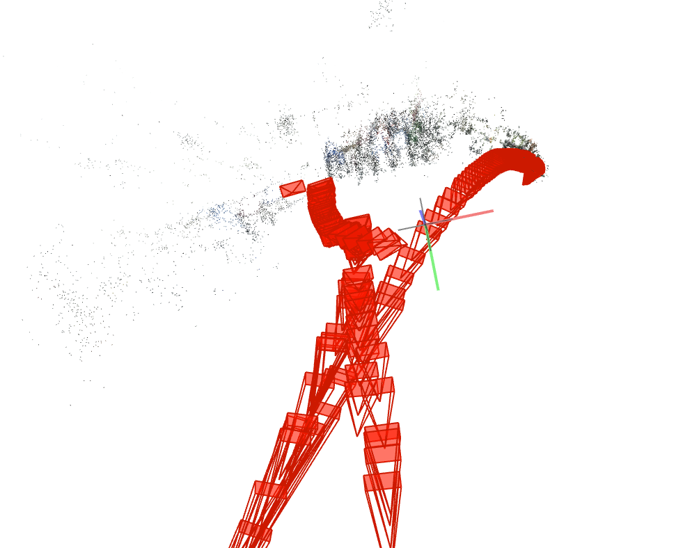
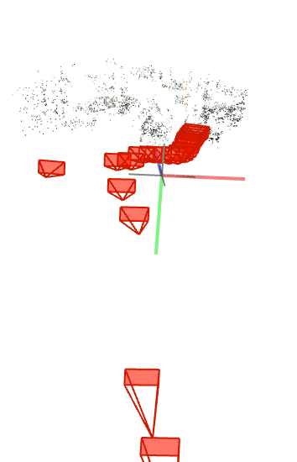
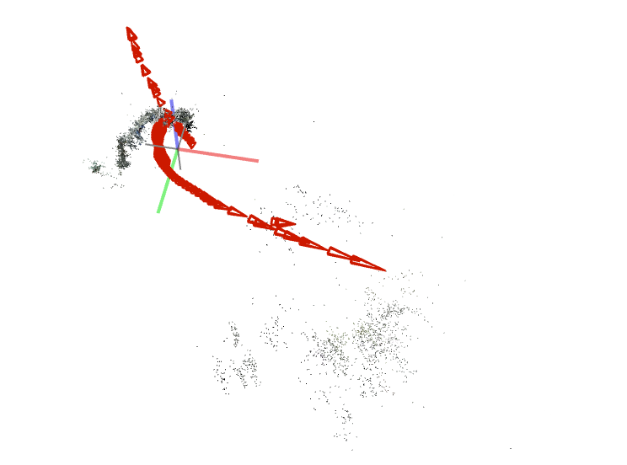
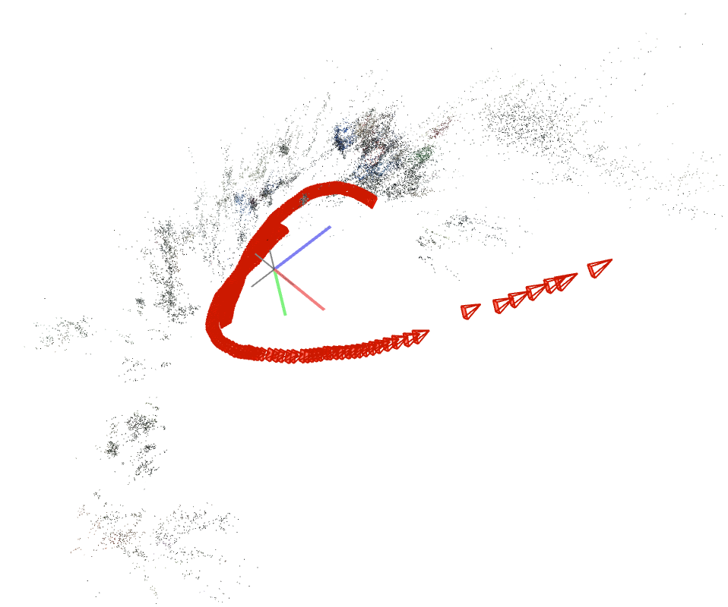
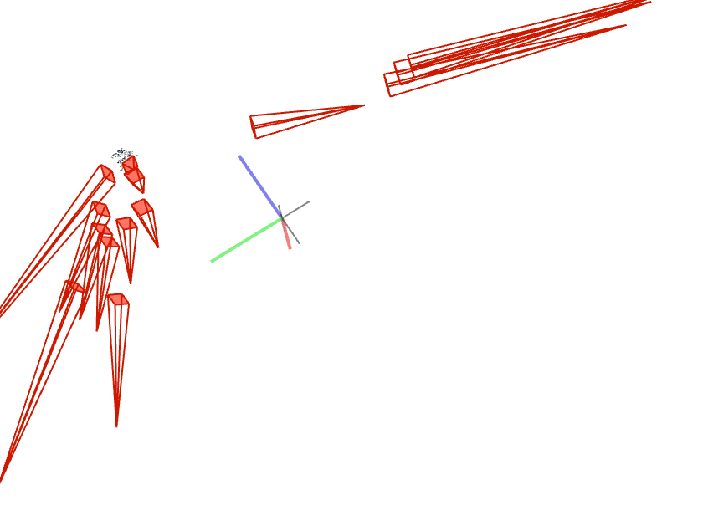
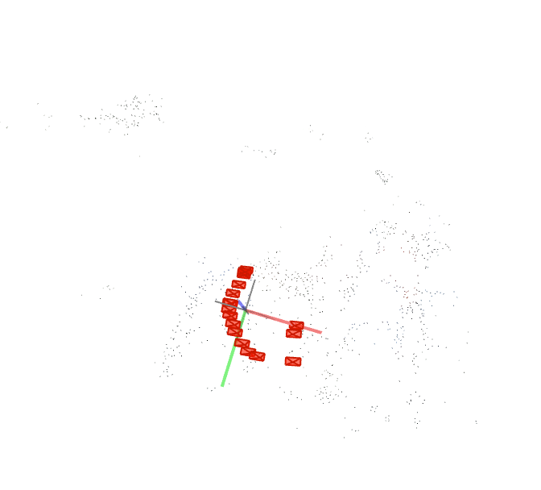
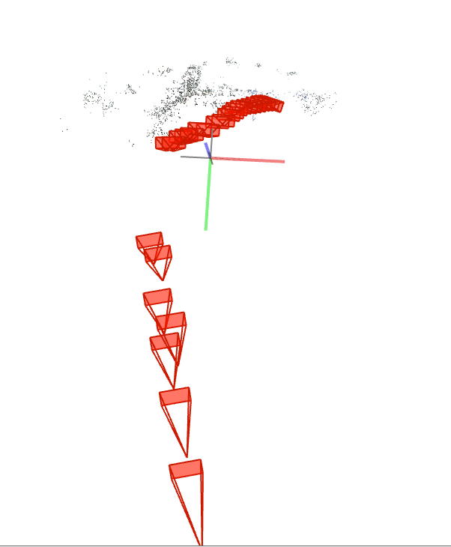
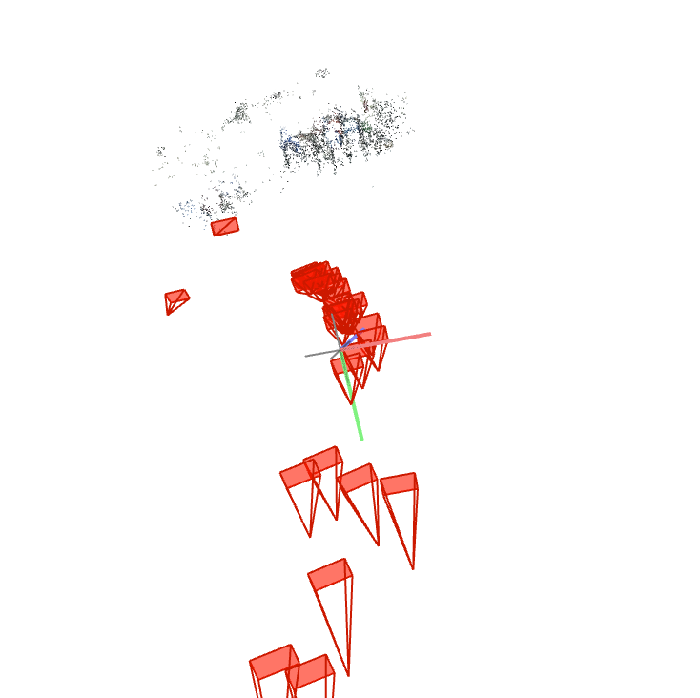
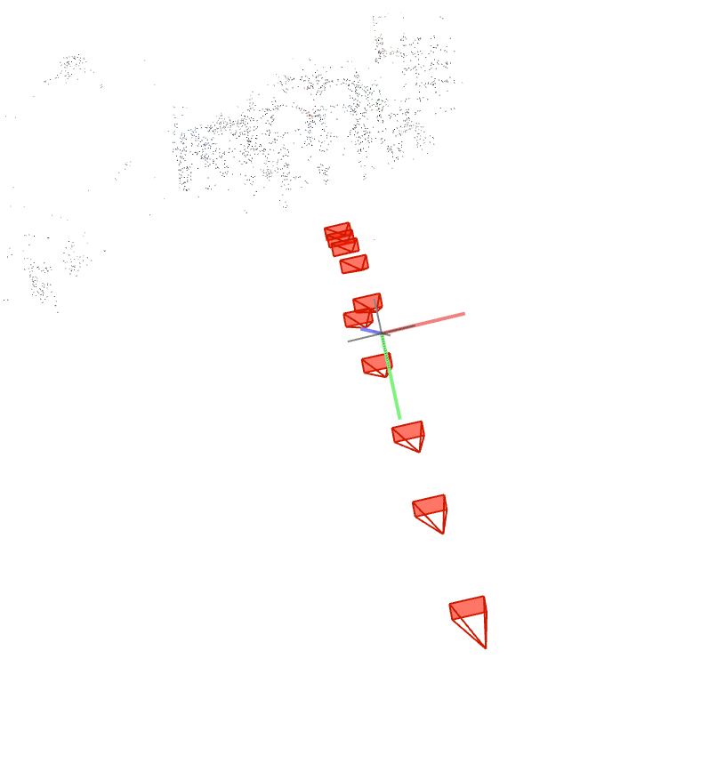
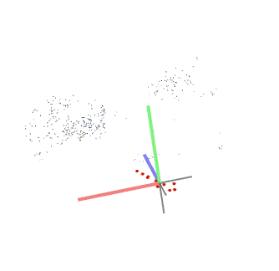
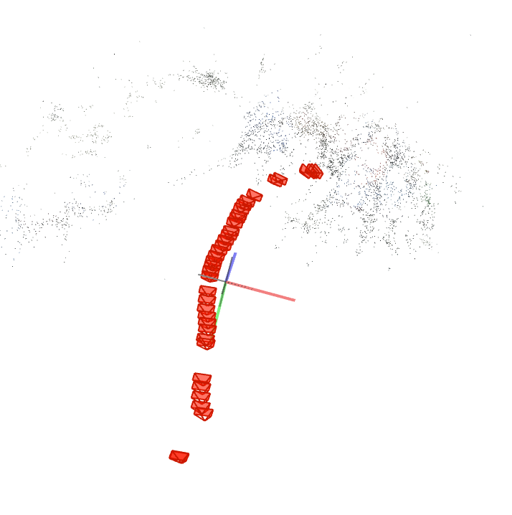
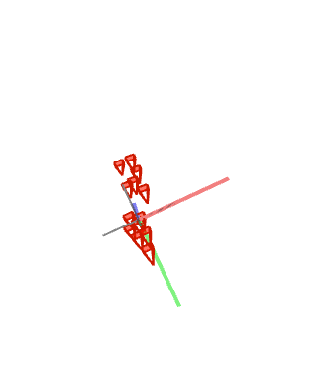
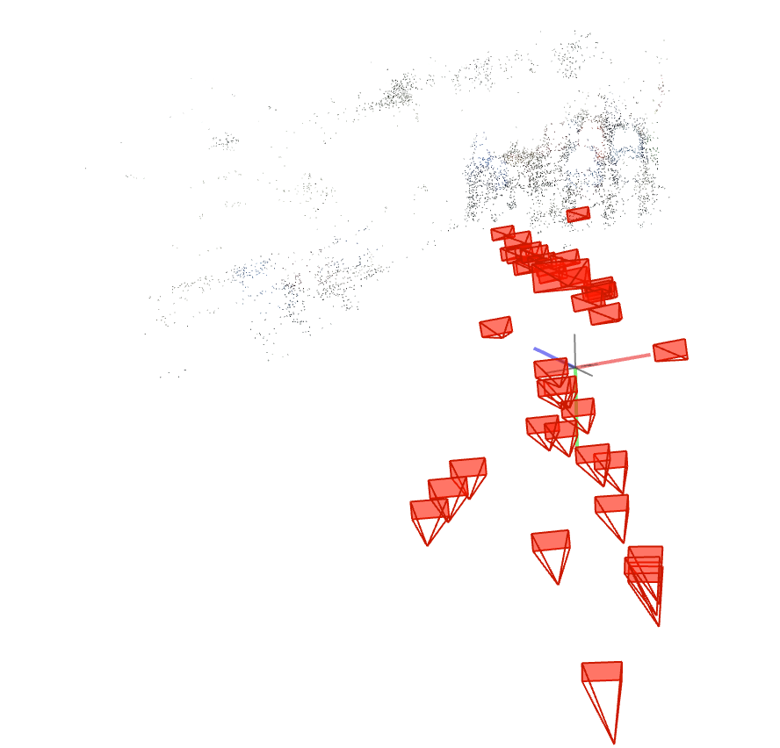
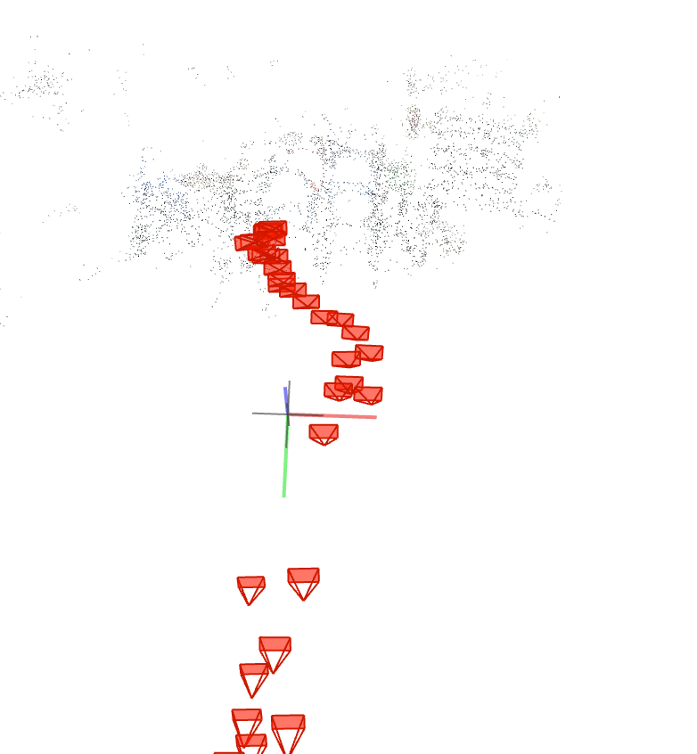
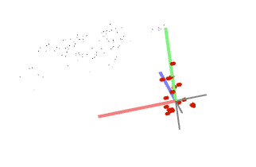
Near, 1000px
FOV 6 Sparse models | SIMPLE_RADIAL_FISHEYE 1 Sparse model | RADIAL_FISHEYE 3 Sparse models | OPENCV_FISHEYE | THIN_PRISM_FISHEYE

Slide 7
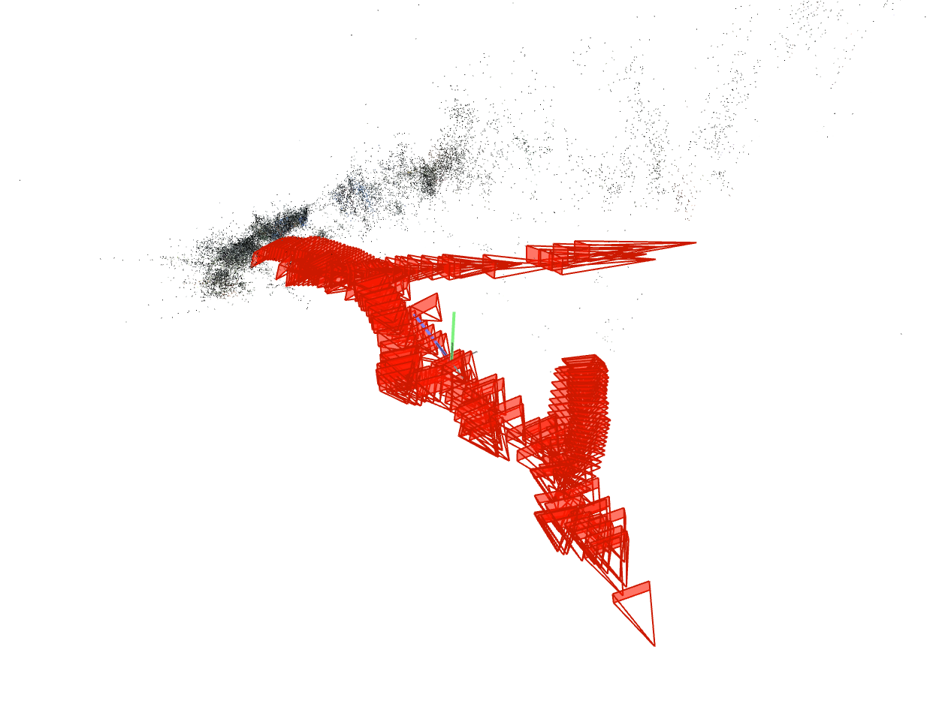
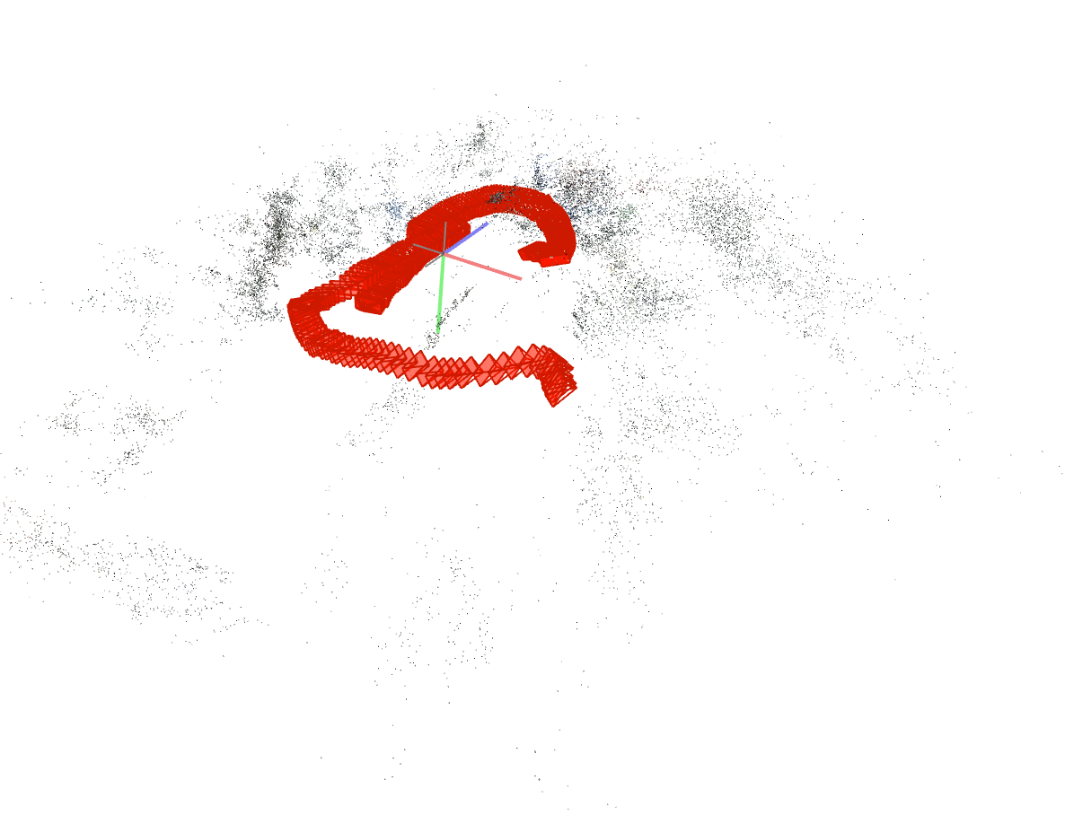
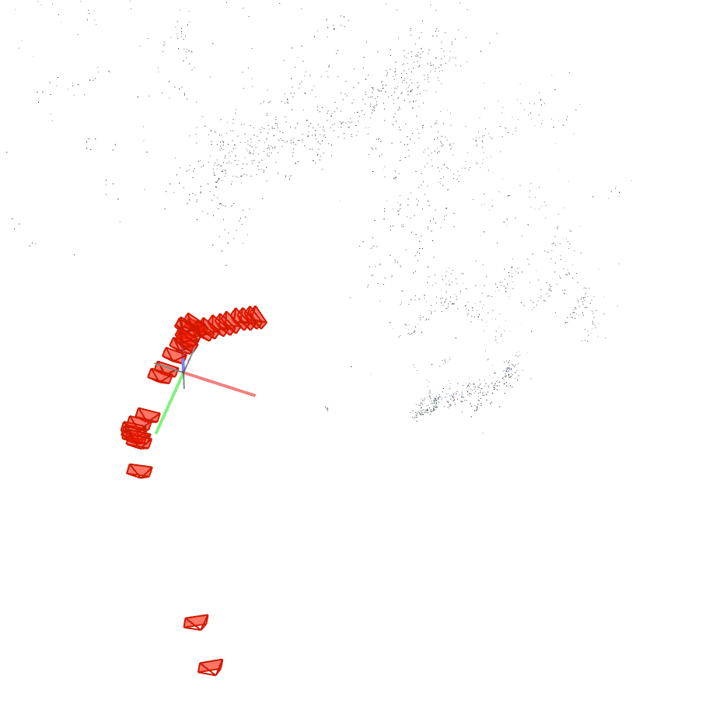
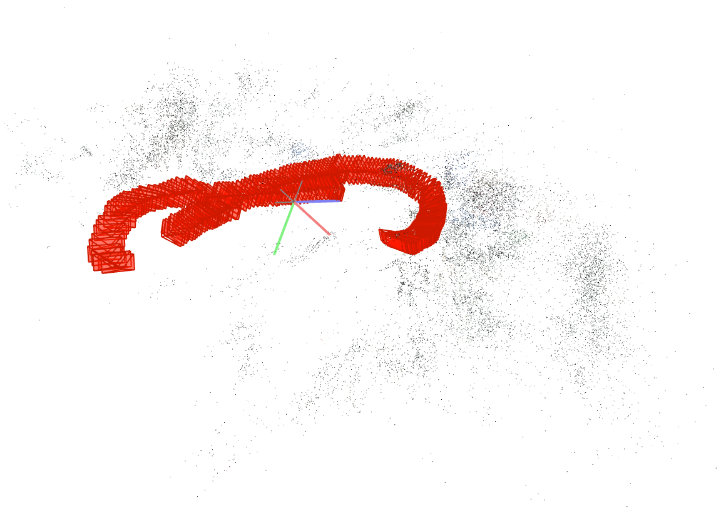
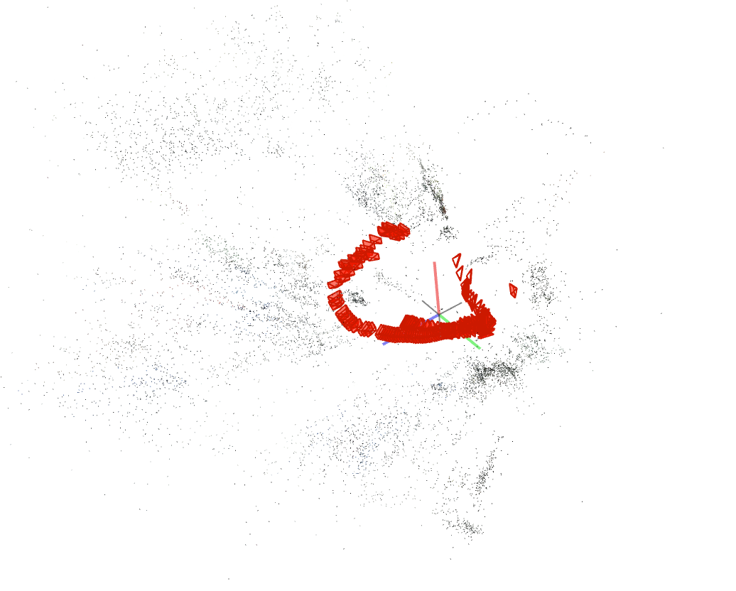
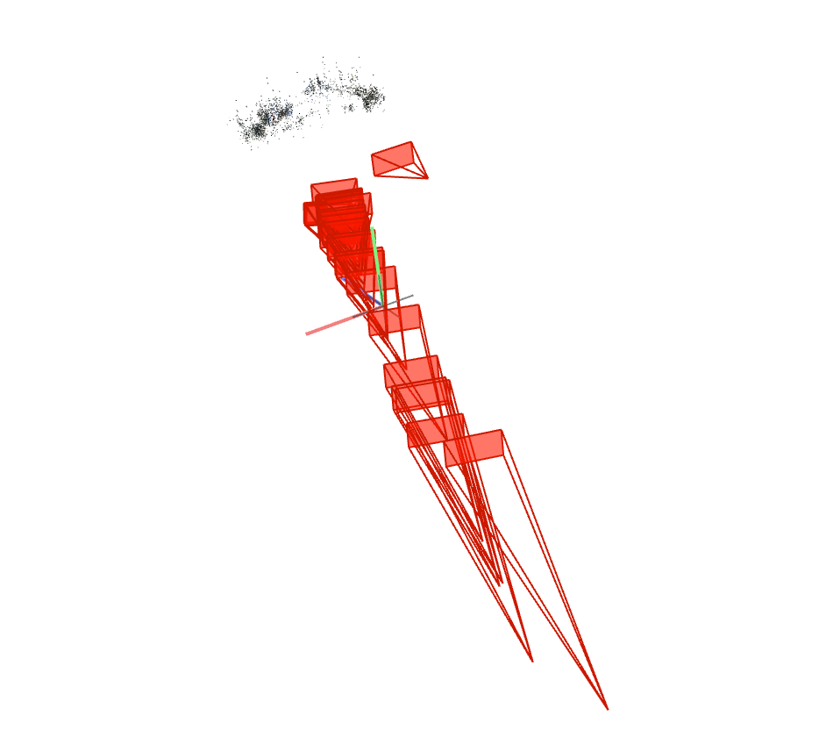
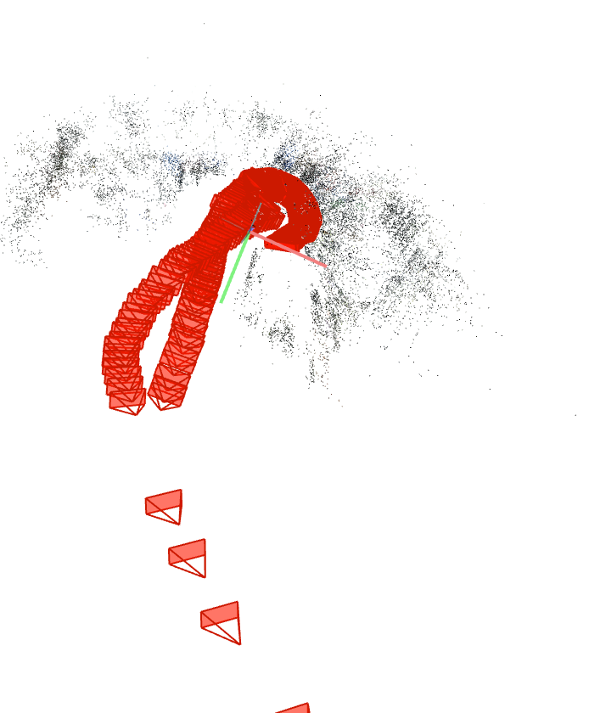
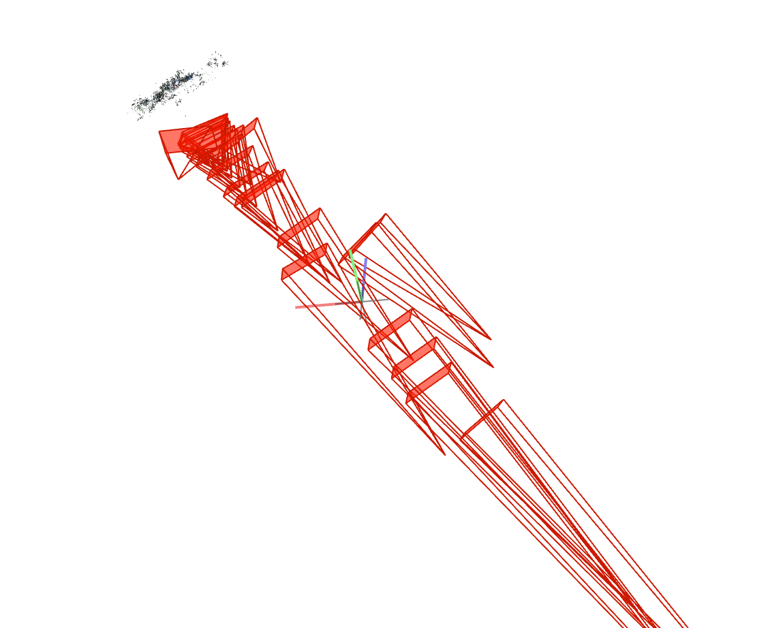
Near, 2000px
FOV 3 Sparse models | SIMPLE_RADIAL_FISHEYE 1 Sparse model | RADIAL_FISHEYE 2 Sparse models | OPENCV_FISHEYE 1 Sparse model | THIN_PRISM_FISHEYE 1 Sparse model

Slide 8
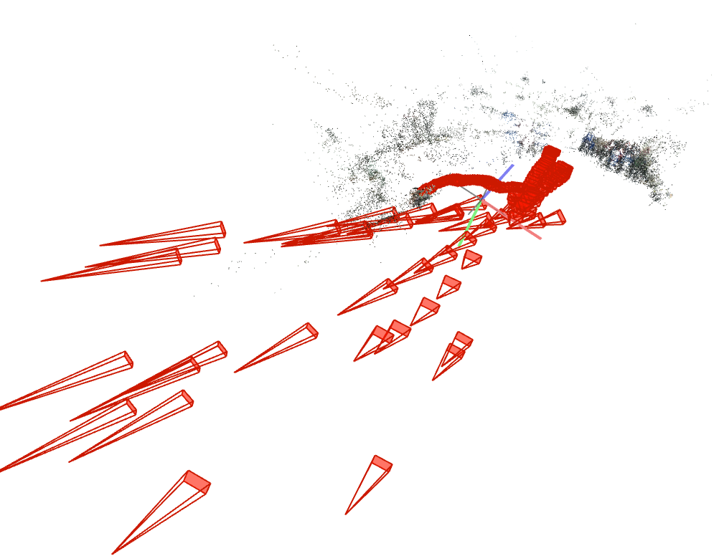
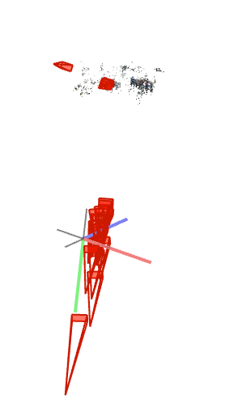
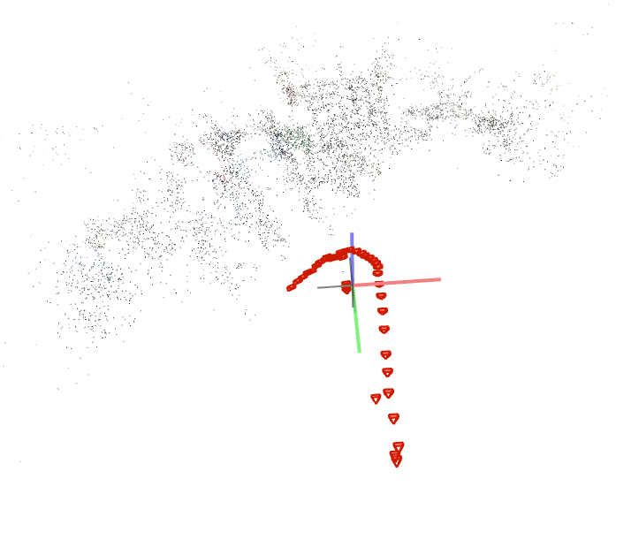
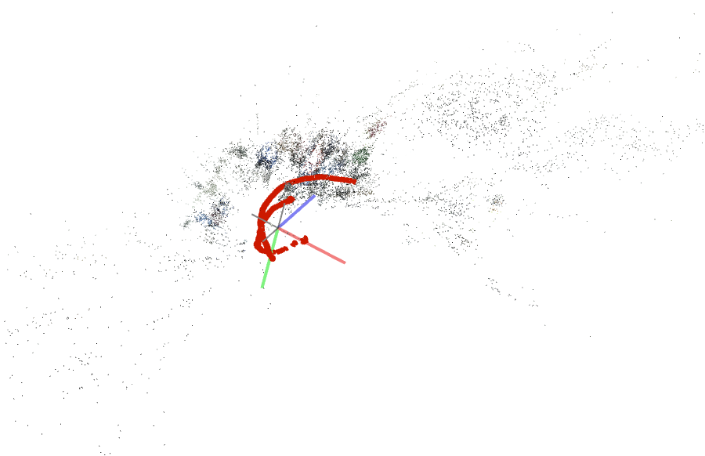
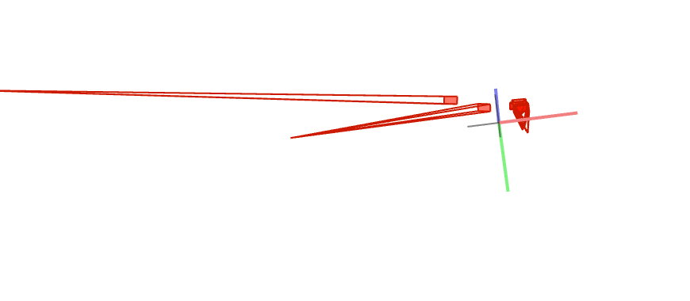
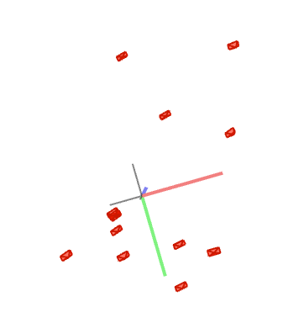
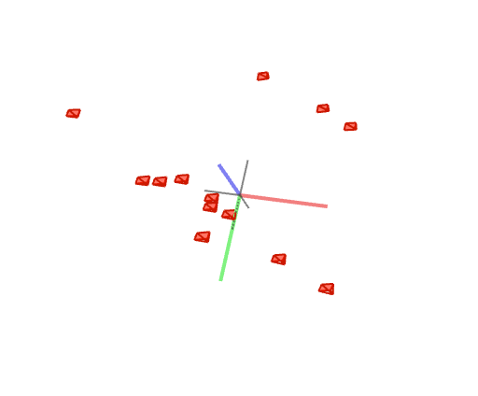
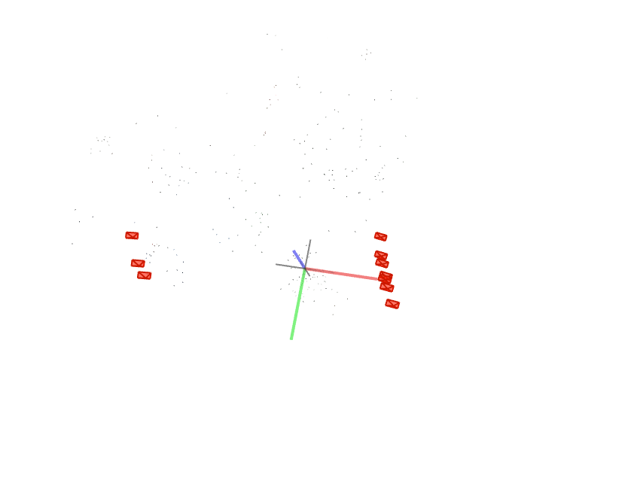
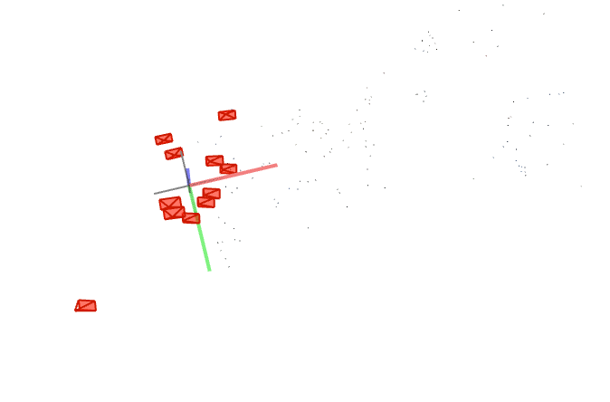
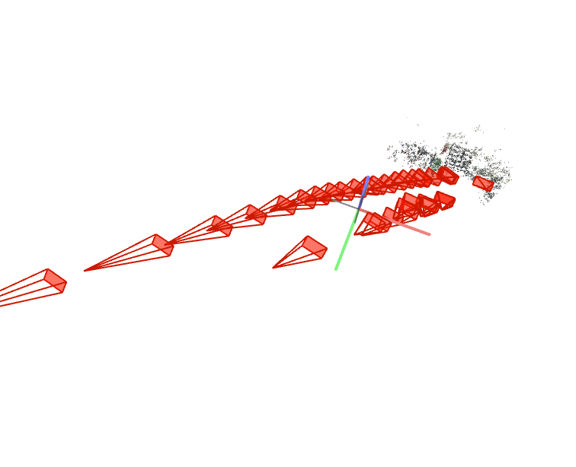
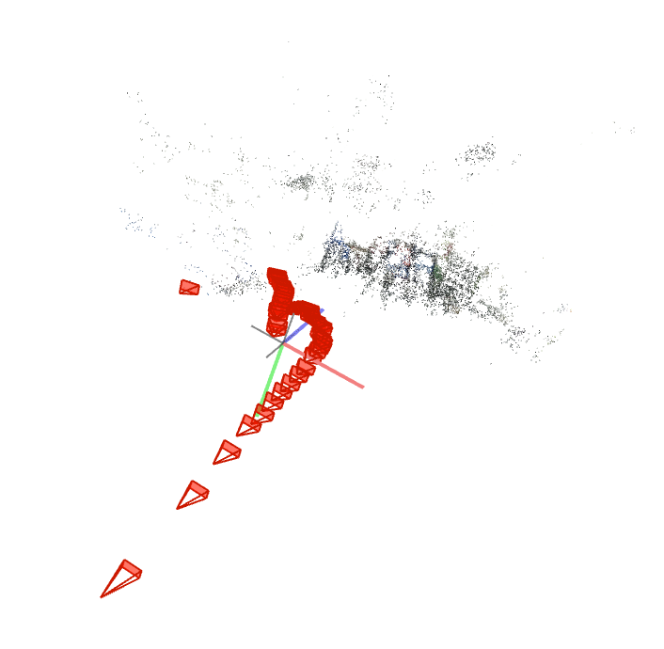
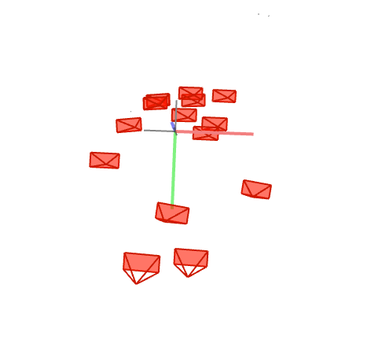
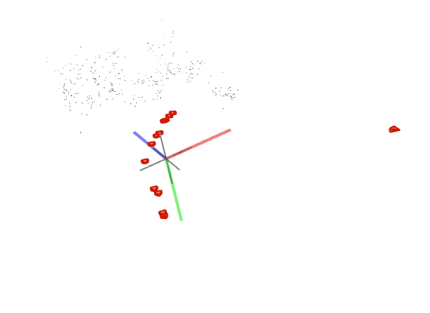
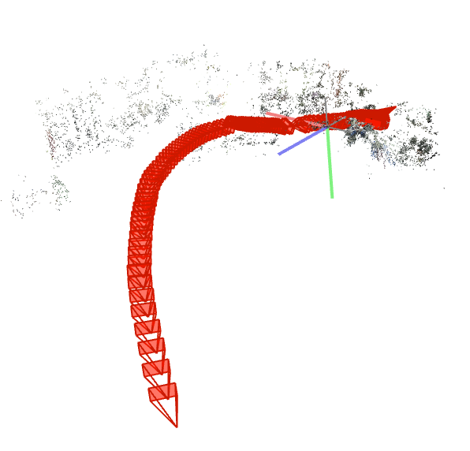
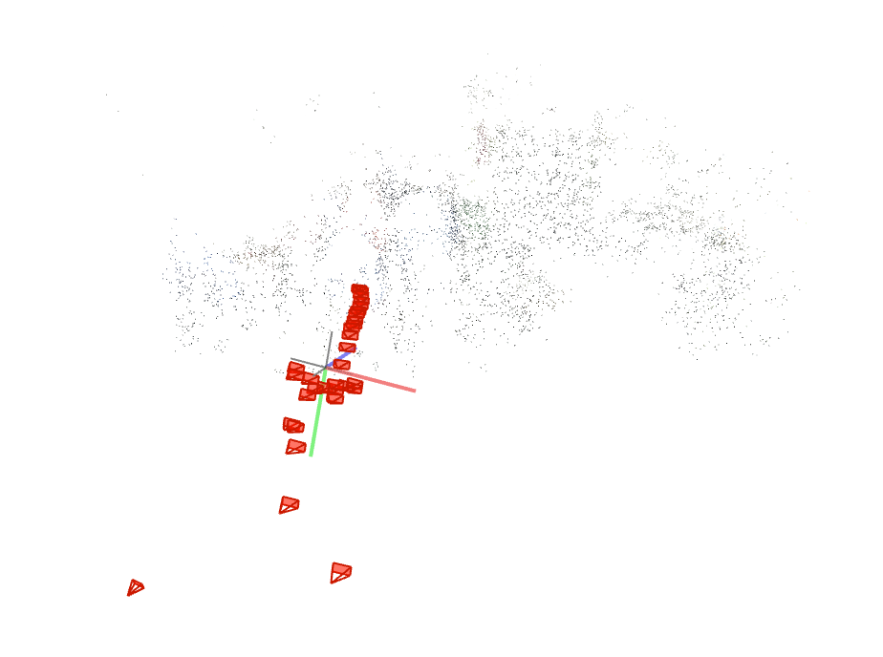
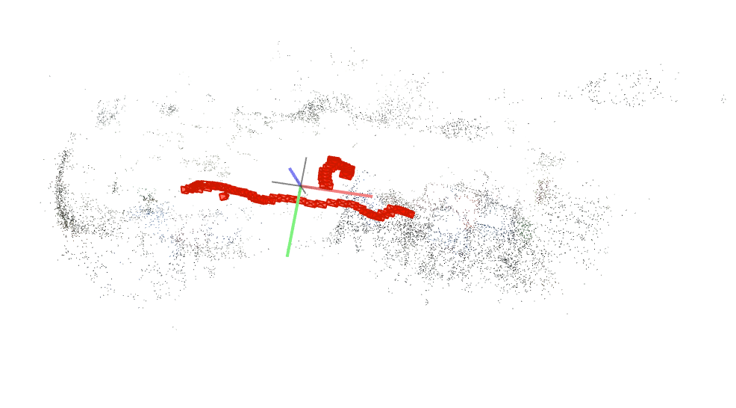
Far,1000px
FOV 5 Sparse models | SIMPLE_RADIAL_FISHEYE 2 Sparse models | RADIAL_FISHEYE 2 Sparse models | OPENCV_FISHEYE 7 Sparse models | THIN_PRISM_FISHEYE 1 Sparse model

Slide 9
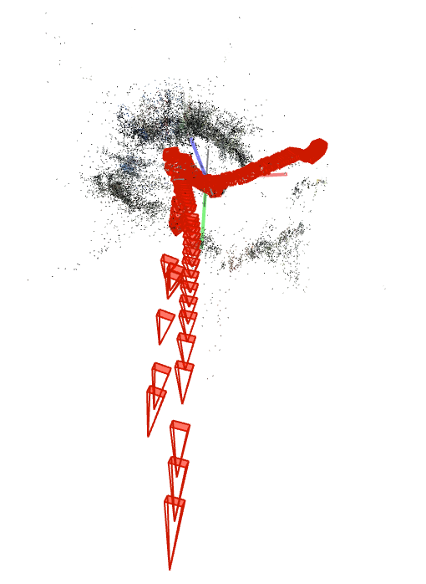
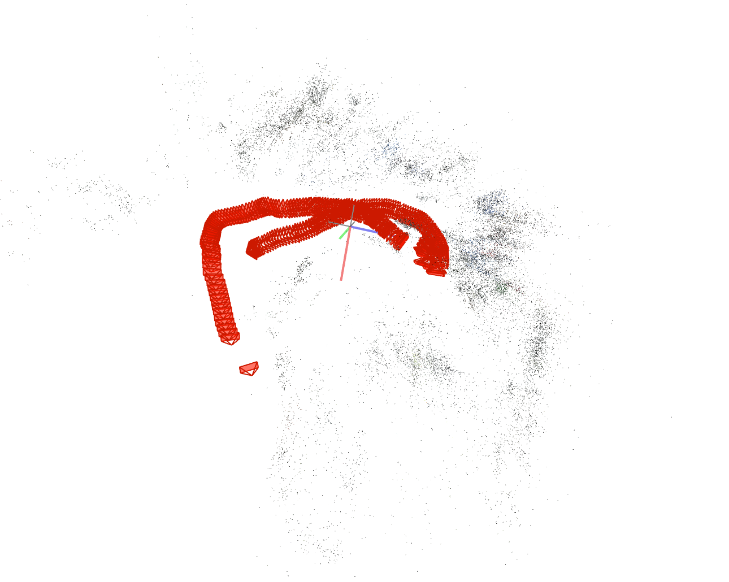
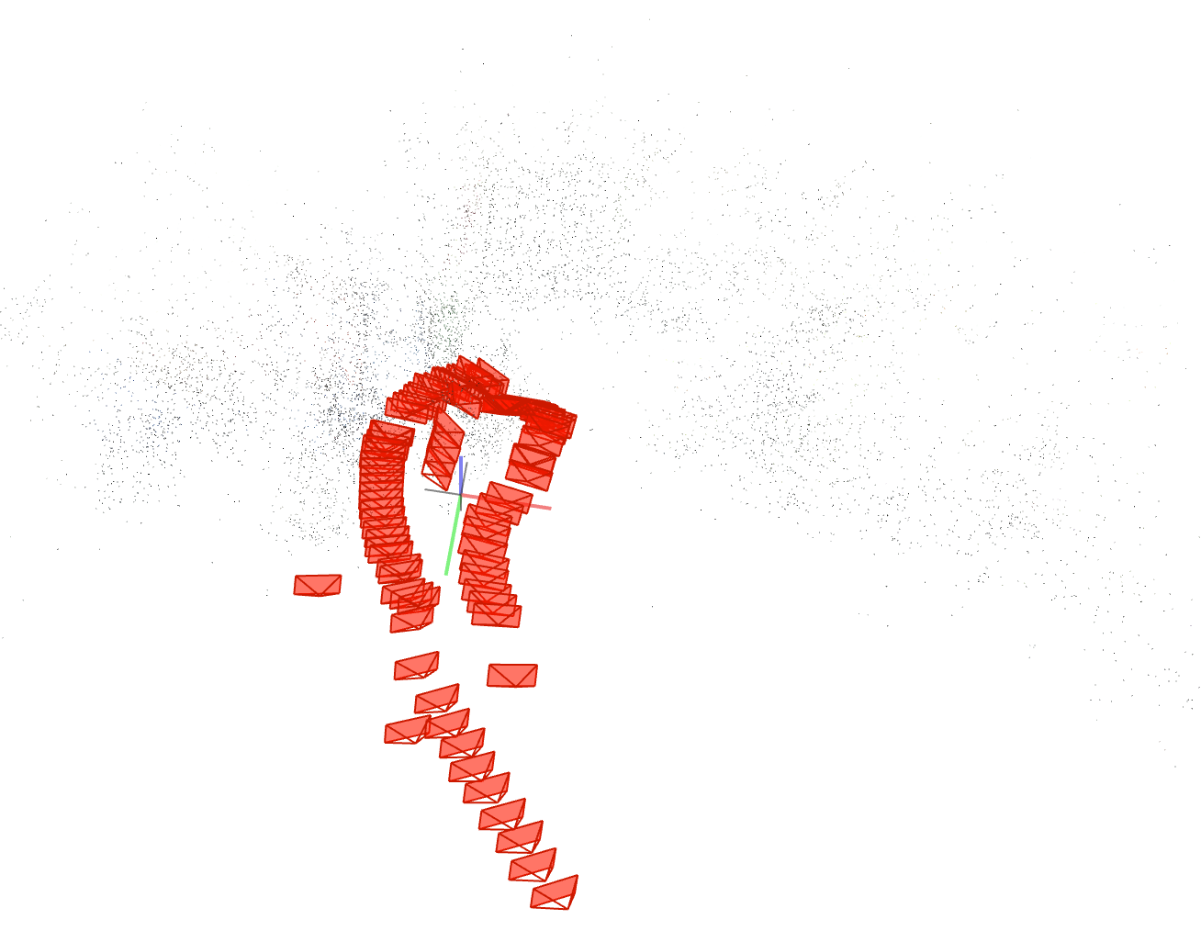
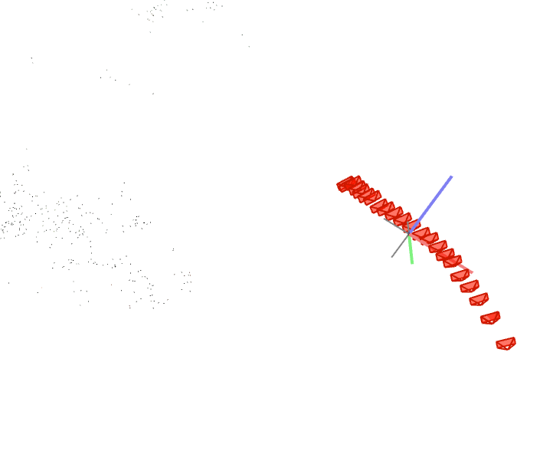
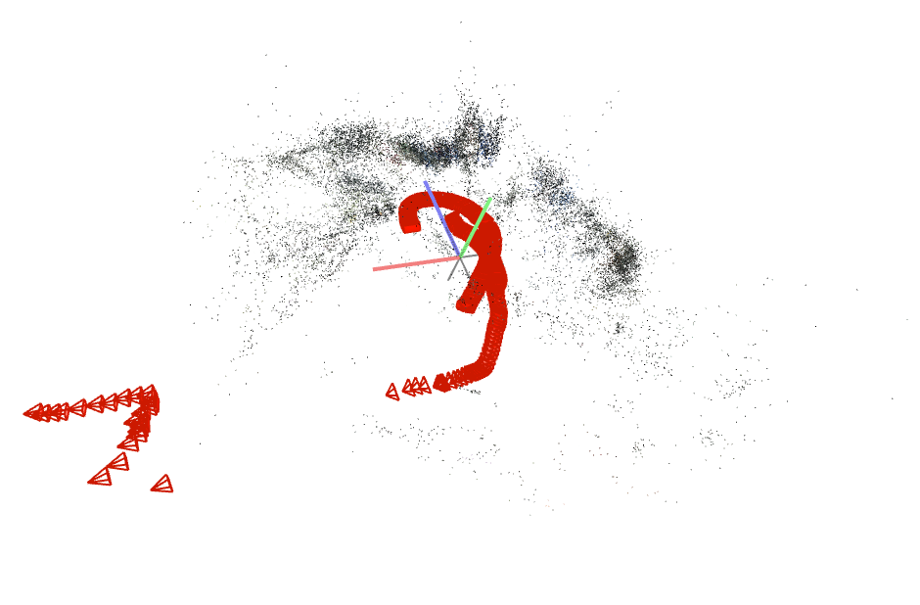
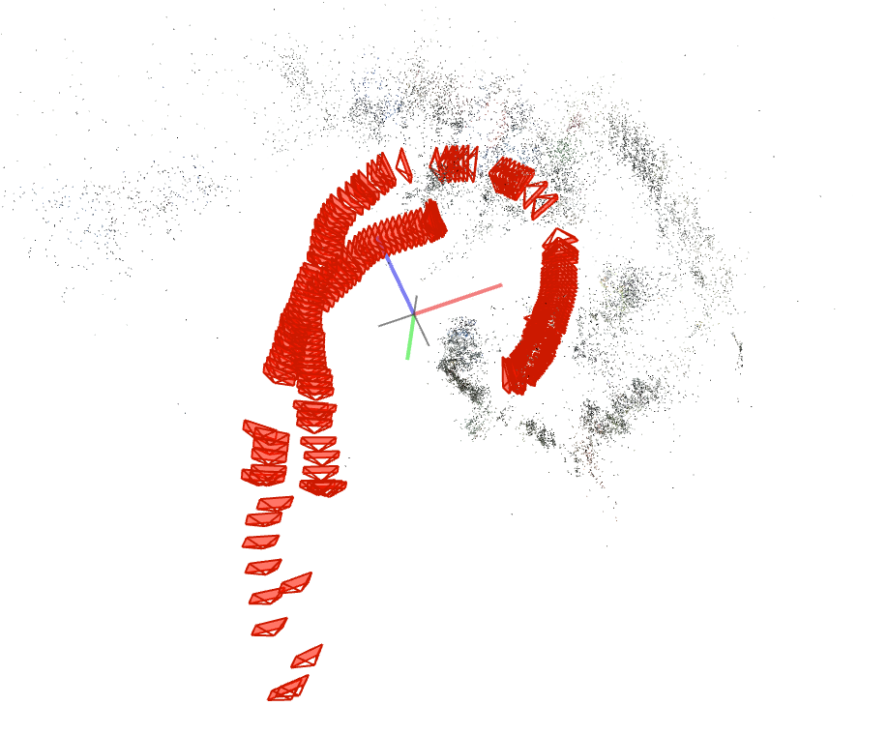
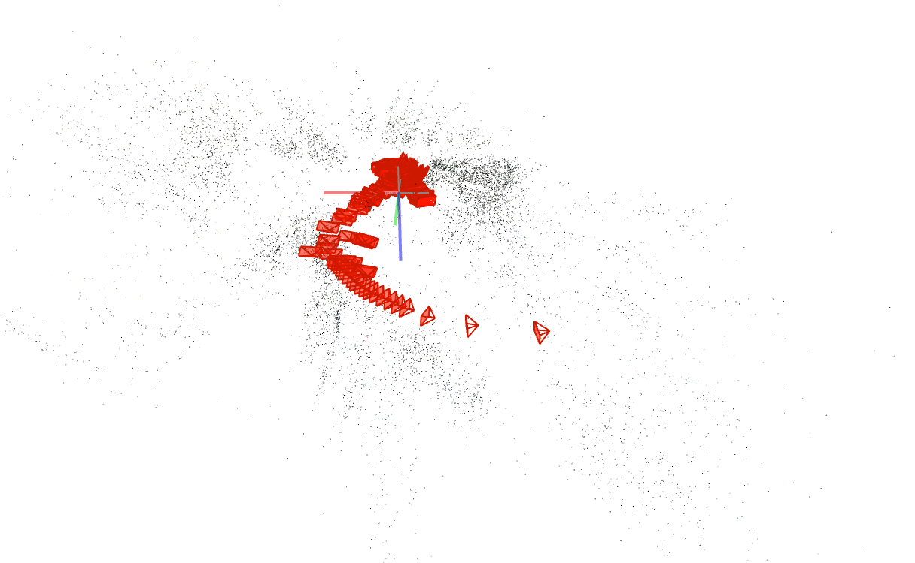
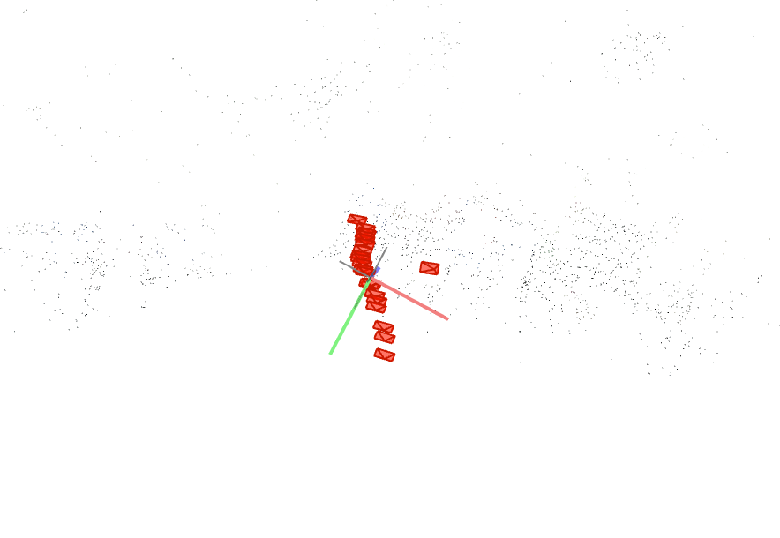
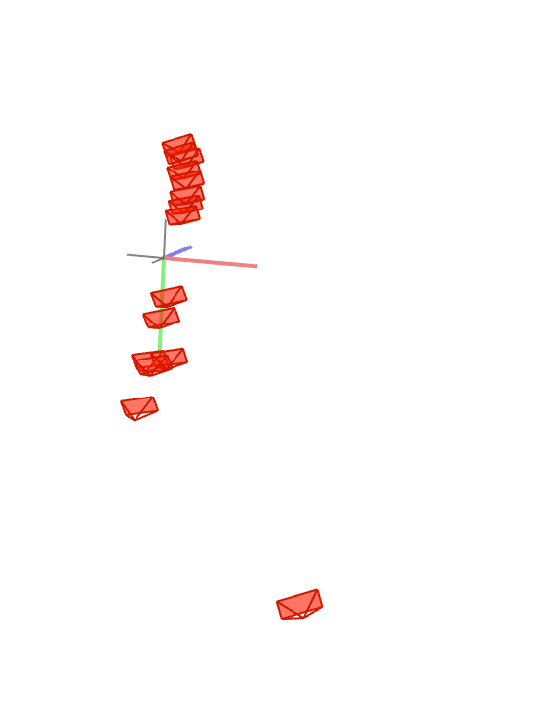
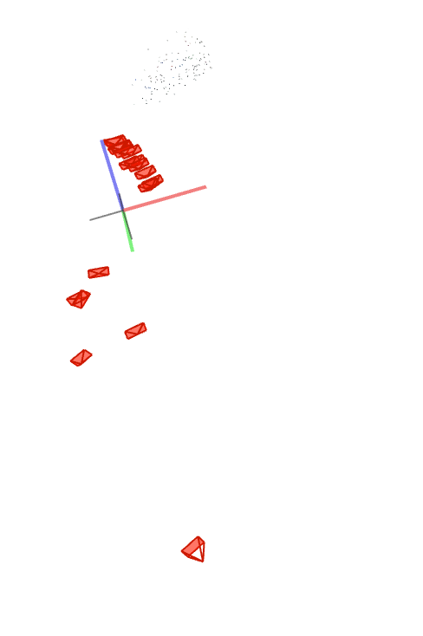
Far, 2000px
FOV 1 Sparse model | SIMPLE_RADIAL_FISHEYE 1 Sparse model | RADIAL_FISHEYE 1 Sparse model | OPENCV_FISHEYE 4 Sparse models | THIN_PRISM_FISHEYE 4 Sparse models

Slide 10
05/01/20
Attempt for 10 experiments at 30 FPS, testing for the double circle path, excessive run time (FOV 2000px 30FPS double circled : over 28 hours run time… not feasible.
Redirected to 4 experiments with the following parameter:
10 FPS
Near stitching
Frame width: {1000, 2000} [px]
Camera models: {FOV, SIMPLE_RADIAL_FISHEYE}

Slide 11
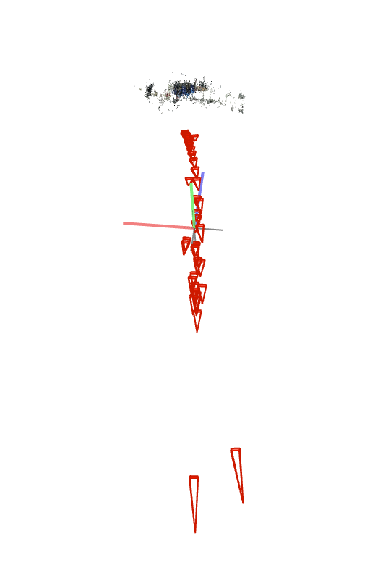



1000px
FOV 12 Sparse models | SIMPLE_RADIAL_FISHEYE 1 Sparse model
FOV 6 Sparse models | SIMPLE_RADIAL_FISHEYE 1 Sparse model
Doubled circled
Single circled

Slide 12


2000px
FOV 1 Sparse model | SIMPLE_RADIAL_FISHEYE 1 Sparse model
FOV 3 Sparse models | SIMPLE_RADIAL_FISHEYE 1 Sparse model
Doubled circled
Single circled

Slide 13
10/01/20
5 experiments with the following parameters:
10 FPS
5 camera models : {SIMPLE_RADIAL_FISHEYE, SIMPLE_RADIAL, RADIAL, SIMPLE_PINHOLE, PINHOLE}
Near stitching
1000px width frames
5 experiments with the following parameters:
20 FPS
5 camera models : {SIMPLE_RADIAL_FISHEYE, SIMPLE_RADIAL, RADIAL, SIMPLE_PINHOLE, PINHOLE}
Near stitching
1000px width frames
1 experiment using buildots extraction and calibration scripts

Slide 14











10 FPS
SIMPLE_RADIAL_FISHEYE 1 Sparse model | SIMPLE_RADIAL 2 Sparse models | RADIAL 3 Sparse models | SIMPLE_PINHOLE 7 Sparse models | PINHOLE 6 Sparse models

Slide 15












20 FPS
SIMPLE_RADIAL_FISHEYE 1 Sparse model | SIMPLE_RADIAL 10 Sparse models | RADIAL 1 Sparse model | SIMPLE_PINHOLE 7 Sparse models | PINHOLE 4 Sparse models

Slide 16

Buildots’s extraction and calibration
FPS : 30
# Frames : 1067
Record length : 36 [s]
Camera distance model : CLOSE
Frame size : 1000x504px
Camera model : default (SIMPLE_RADIAL)
Sparse models : 1

Slide 17
13/01/20
Extraction and calibration performed using buildots’s provided scripts
3 experiments with the following parameters:
Frame size: 1000x504 px
Camera models : {SIMPLE_RADIAL_FISHEYE, SIMPLE_RADIAL, OPENCV}
3 experiments with the following parameters:
Frame size : 2000x1008px
Camera models : {SIMPLE_RADIAL_FISHEYE, SIMPLE_RADIAL, OPENCV}

Slide 18







1000 px
SIMPLE_RADIAL_FISHEYE 1 Sparse model | SIMPLE_RADIAL 1 Sparse model | OPENCV 7 Sparse models

Slide 19









2000 px
SIMPLE_RADIAL_FISHEYE 4 Sparse models | SIMPLE_RADIAL 6 Sparse models | OPENCV 1 Sparse model

Slide 20

CONCLUSION
None of the 6 experiments are a success
Buildots’s calibration script is not suited for frame of width ≠ 1000px

Slide 21
Where should we explore next?
We could not reach an accurate sparse model from Colmap with any of the method used so far for the following reasons:
Lack of texture in part of the dataset (white walls, white board,…)
Not enough feature points were detected by the feature extraction in Colmap
Ideas to explore:
Garmin VIRB 360 has a raw data mode, recording with a 5K resolution (instead of 4K for the regular 360° recording) and not stitching the frames. This would help Colmap in extracting more feature points.
Studying in depth how Colmap parameters could be of help for a low textured dataset
After researching blogs and forums on photogramettry, it seems that decomposing our 360 frame into a set of several FOV equirectangular frames would perform better on Colmap than limiting ourselves to a single smaller calibrated frame.

Slide 22
20/01/20
Try at using the 5k and 5.7K resolution from Garmin VIRB 360 (as opposed to 4K previously) so as to possibly increase the amount of feature points detected by Colmap.
Best 4 Camera models tested: SIMPLE_RADIAL_FISHEYE, RADIAL_FISHEYE, RADIAL, FOV
10/20 FPS comparison

Slide 23
GENERALS
4K recording was previously performed, the camera is stitching together front and back image to give an output video of 2880x2880[px] out of which we extracted only the center of 1100x500[px] in order to compare with the 5K
5K records separately 2 video (front/back) each of 2160x2160[px] with a 201.8° FOV
5.7K* records separately 2 video (front/back) each of 2880x2880[px] with a 201.8° FOV
*5.7K recording can only be activated through the Garmin VIRB mobile app

Slide 24




10 FPS 5K
SIMPLE_RADIAL_FISHEYE 1 Sparse model | SIMPLE_RADIAL 1 Sparse model | RADIAL 1 Sparse model | FOV 1 Sparse model

Slide 25




10 FPS 5.7K
SIMPLE_RADIAL_FISHEYE 1 Sparse model | SIMPLE_RADIAL Sparse model | RADIAL 1 Sparse model | FOV 3 Sparse models

Slide 26




20 FPS 5K
SIMPLE_RADIAL_FISHEYE Sparse model | SIMPLE_RADIAL 1 Sparse model | RADIAL 1 Sparse model | FOV 1 Sparse model

Slide 27




20 FPS 5.7K
SIMPLE_RADIAL_FISHEYE 1 Sparse model | SIMPLE_RADIAL 1 Sparse model | RADIAL 1 Sparse model | FOV 3 Sparse models

Slide 28


COMPARISON 4K/5K
4K
5K

Slide 29
23/01/20
Stabilization for 5K and 5.7K recordings
As stabilization is not done automatically by Garmin VIRB 360 for resolution bigger than 4K, the previous experiment on 5K and 5.7K was performed without stabilization. We are now interested in showing results with image stabilization
The stabilization was done post recording using a high end video editing software.
G-Metrix necessary to use the Garmin VIRB edit stabilization.

Slide 30




10 FPS 5K
SIMPLE_RADIAL_FISHEYE | SIMPLE_RADIAL | RADIAL | FOV
STABILIZED

Slide 31




10 FPS 5.7K
SIMPLE_RADIAL_FISHEYE 1 Sparse model | SIMPLE_RADIAL 1 Sparse model | RADIAL | FOV
STABILIZED

Slide 32
CONCLUSION
Stabilization has modified the video in both frame size and FPS.
NEXT:
Test the Garmin VIRB edit for stabilization, as this was made specificaly for this camera
Multiple room test
Lowering to 0-10 FPS test

Slide 33
30/01/20
Stabilization for 5K and 5.7K recordings using Garmin VIRB Edit app
Multi-room test
5 FPS test

Slide 34
STABILIZATION TESTS
Connecting the camera directly to the Garmin VIRB edit software
Garmin VIRB stabilization only available if G-metrix available.
Tests at 10FPS for the Colmap spherical camera models
Single room
Caution: Garmin VIRB edit has stitched back and front camera in order to stabilize the frames. Need to take this in account.

Slide 35




10 FPS 5K
SIMPLE_RADIAL_FISHEYE | SIMPLE_RADIAL | RADIAL | FOV
STABILIZED

Slide 36




10 FPS 5.7K
SIMPLE_RADIAL_FISHEYE | SIMPLE_RADIAL | RADIAL | FOV
STABILIZED

Slide 37


POSSIBLE REASON FOR FAILURE
Unstabilized
stabilized
Experiment failed due to less details within the new frame frame, ‘zoom’ effect.
(Notice that each of the camera models have output between 6 and 14 sparse models, emphasizing the lack of features in order to understand that the recorded room was one single volume entity).

Slide 38
CORRECTION : INCREASE FRAME SIZE
Stabilization with Garmin VIRB edit app only possible after stitching back and front camera => need to take in account for the stitching to ‘zoom’ in the frame.
5K crop center from 1100x500 to 1400x650
5.7K crop center from 1400x650 to 1600x800

Slide 39




CORRECTION : 10 FPS 5K
SIMPLE_RADIAL_FISHEYE | SIMPLE_RADIAL | RADIAL | FOV
STABILIZED

Slide 40




CORRECTION : 10 FPS 5.7K
SIMPLE_RADIAL_FISHEYE | SIMPLE_RADIAL | RADIAL | FOV
STABILIZED

Slide 41




CONCLUSION
Stabilization with Garmin VIRB app seems to affect Colmap calibration.
Unstabilized
Stabilized
Must stabilize the video without Garmin VIRB edit in order to avoid the stitching distortion

Slide 42
MULTI-ROOM TEST
5K
10FPS
Colmap spherical camera models
Non stabilized video

Slide 43













10 FPS 5K
SIMPLE_RADIAL_FISHEYE | SIMPLE_RADIAL | RADIAL | FOV
SINGLE
DOUBLE

Slide 44
LOWERING FPS TEST
5K
5FPS
Colmap spherical camera models
Single room

Slide 45




5 FPS 5K (RUNTIME ~ 5 [minutes])
SIMPLE_RADIAL_FISHEYE | SIMPLE_RADIAL | RADIAL | FOV
10 FPS
5 FPS

Slide 46
CONCLUSION
From all the previous experiments run, we can now conclude that the dominant parameters for sfm to yield a correct sparse model and estimate camera poses are :
Frame size
Camera model
Proper calibration
5 FPS yields to similar sparse model than 10 FPS, therfore can be used for faster computation
Next : Improve pre process of data (calibration and stabilization)

